Slide 1
Changing Local Consumer Landscape
… And The Future of GBA Consumers Opportunities

Slide 4
HK Survey Period: 17-23 November 2022
Age
25 to 55+
Gender
Social grade
49%
51%
Below university degree
University degree or above
Male: 52%
Female: 48%
Household income
62%
38%
N
1,115
HK 30,000 or below
Above HKD 30,000

Slide 5
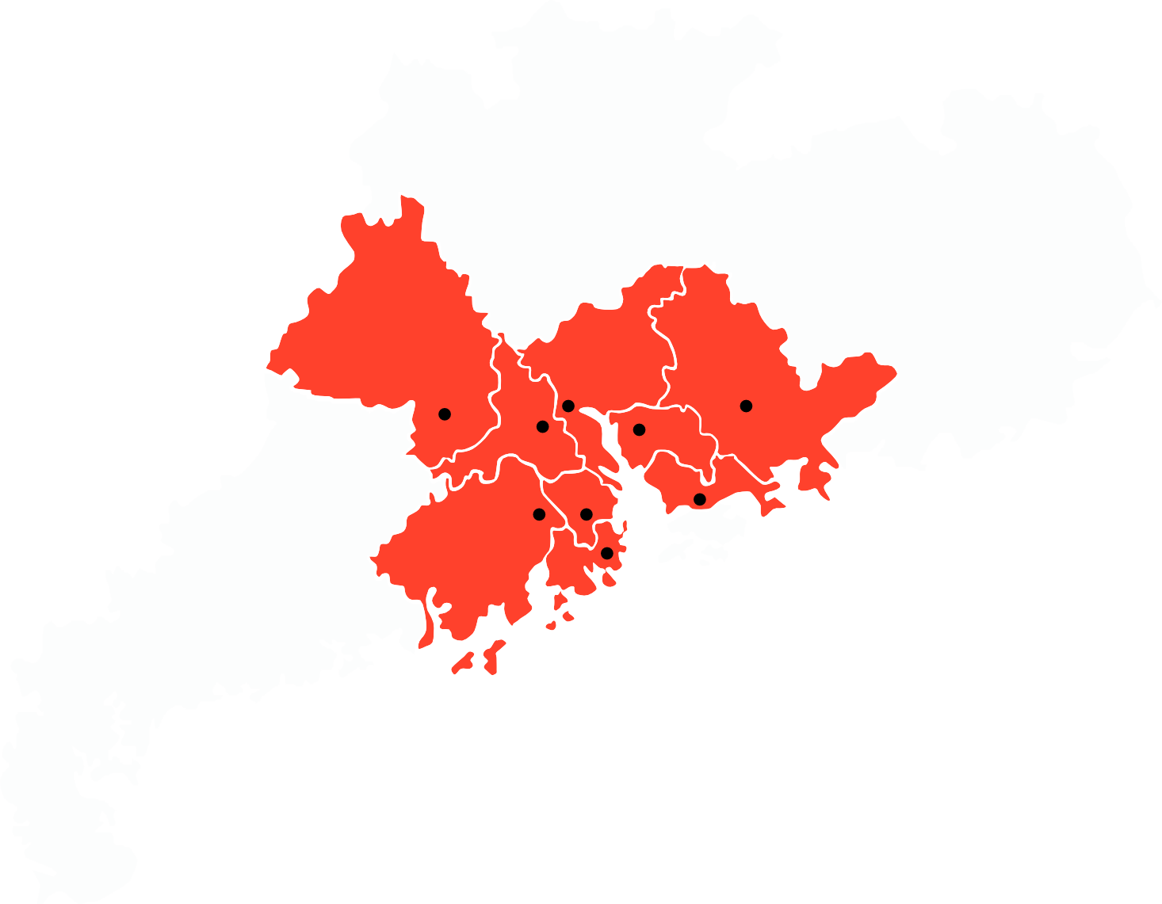
GBA Survey Period: 18-25 October 2022
Age
25 to 55+
Gender
Cities covered
Social grade
Huizhou
13%
87%
Foshan
Guangzhou
Zhaoqing
Below university degree
University degree or above
Male: 53%
Female: 47%
Household income
High
Medium
52%
41%
Shenzhen
N
1,517
Jiangmen
Dongguan
Zhongshan
Zhuhai
Low
7%
RMB 8,000
or below
RMB 8,001
to 20,000
Above RMB 20,000

Slide 6
Sypnosis
Covid has accelerated the digital adoption of consumers from offline to online
Traditional retailers have invested heavily recently in their O2O transformation but are struggling against the early entrants and other emerging channels
With the proximity of the World Cup and winter festivities, households are much more likely to consume during Xmas and New Year
The recent opening of the world’s largest standalone duty- free mall in Haikou, GBA consumers are more likely to choose Haikou (52%) over Hong Kong (38%) when they next travel, with Macau being the least desirable (6%).

Slide 7
How has Covid transformed the local retail landscape?

Slide 8
Traditional Retailers Are Playing Catch Up In The O2O Space
Past 2 weeks online purchase by channel

Slide 9
Yesterday’s Emerging Channels Are Becoming Today’s Established Channels
Past 2 weeks purchase by selected retail banners

Slide 10
Household dining habits continues to fluctuate significantly…
Everyday 7%
None 11%
Everyday 16%
4-6 times per week 17%
None 44%
1-3 times per week 42%
1-3 times per week 32%
4-6 times per week 31%
10-16 March
27-1 November
Dining-out frequency past 2 weeks

Slide 11
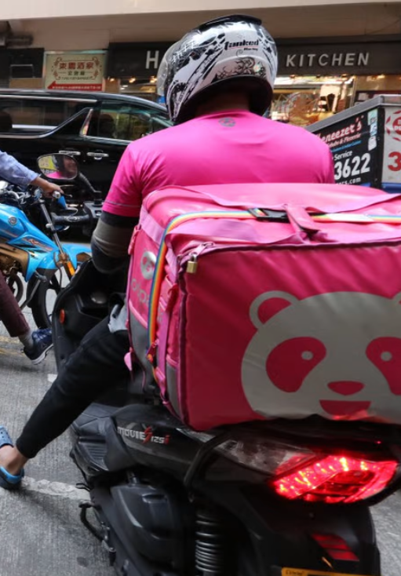
… Food aggregators have remained popular as households dining habits continues to evolve
Food aggregators used in the past 2 weeks

Slide 12
How will Hong Kong’s households celebrate the World Cup and upcoming festivities?

Slide 13
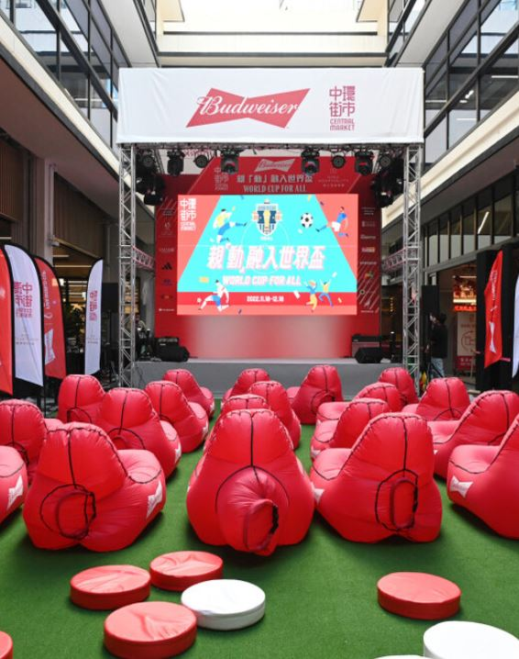
Seasonal celebrations will take precedence over the World Cup
8% are planning to celebrate the World Cup out-of-home
36% are planning to celebrate their Xmas and the New Year out-of-home

Slide 14
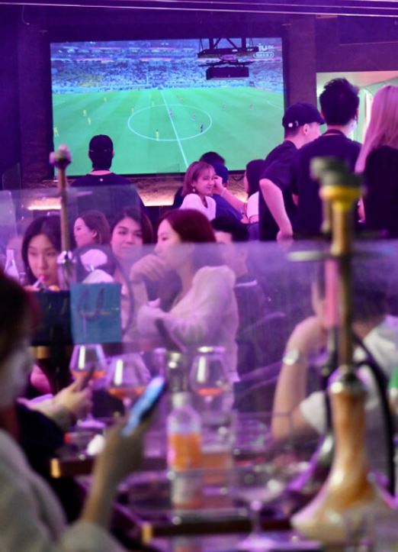
Excluding food, half of the consumers are willing to spend $100 or more out-of-home
$401 or more 6%
$301 to $400 8%
Less than $50 23%
$201 to $300 15%
$50 to $100 26%
$101 to $200 23%
Planned out-of-home beverage spending per occasion

Slide 15
Bars & clubs channel will dominate the World Cup, whilst Western & fine dining features strongly for Xmas
Others 5%
Others 9%
Fine dining 10%
Chinese 7%
Chinese 9%
Fine dining 23%
Western 15%
Bars & clubs 57%
Bars & clubs 17%
Western 47%
World Cup Planned Visit By Channel
Xmas Planned Visit By Channel

Slide 16
How will GBA consumers behave when the border reopens?

Slide 27
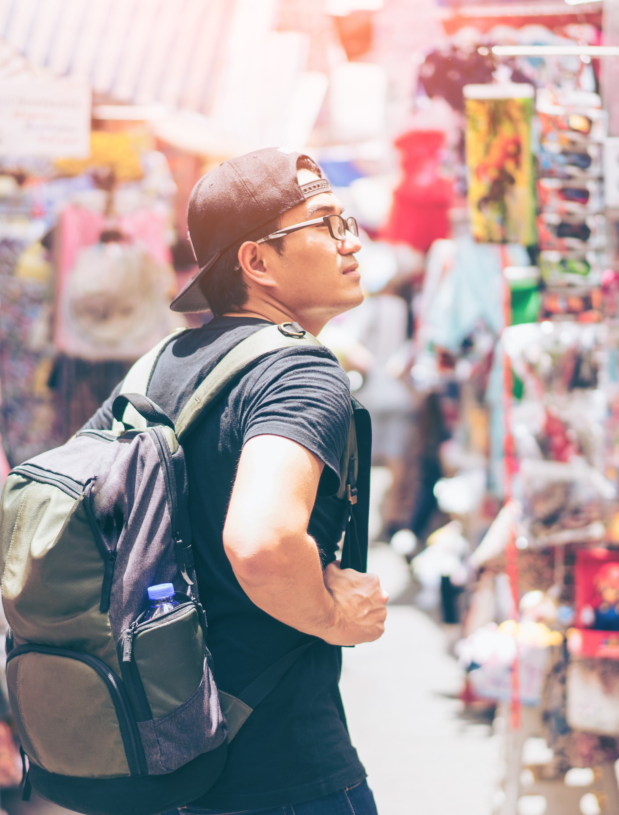
What Should Businesses Do To Attract Local And GBA Consumers?
OMNI and other channels are here to stay as brands need to prioritise their resources to develop the white-space opportunities.
As Hong Kong is planning to reset and reopen its borders, this potential loss of those previous visitors might not be a bad thing.
Hong Kong has the potential to attract higher quality GBA consumers and offer a more superior shopping experience.
It is vital for retailers and brands to remain at the forefront of innovation and be early adopters.

